Slide 1

KNN ALGORITHM K-Nearest-Neighbor

Slide 2
Our Team
Laiba Athar
L1F20BSSE0207
Sara Arshad
L1F20BSSE0226
L1F20BSSE0005
Khadija Fatima
Umair Aslam
L1F20BSSE0385
L1F20BSSE0383
Maryam Maqsood

Slide 3

WHAT IS KNN?
K-Nearest Neighbors (KNN) is a machine learning algorithm for classification. It predicts the class or value of a new data point by considering the majority class or average of its K nearest neighbors in the feature space. The algorithm assumes that similar instances in the dataset have similar output values, making it a simple yet effective approach for various tasks. The choice of K is an important parameter that influences the algorithm's performance.

Slide 4
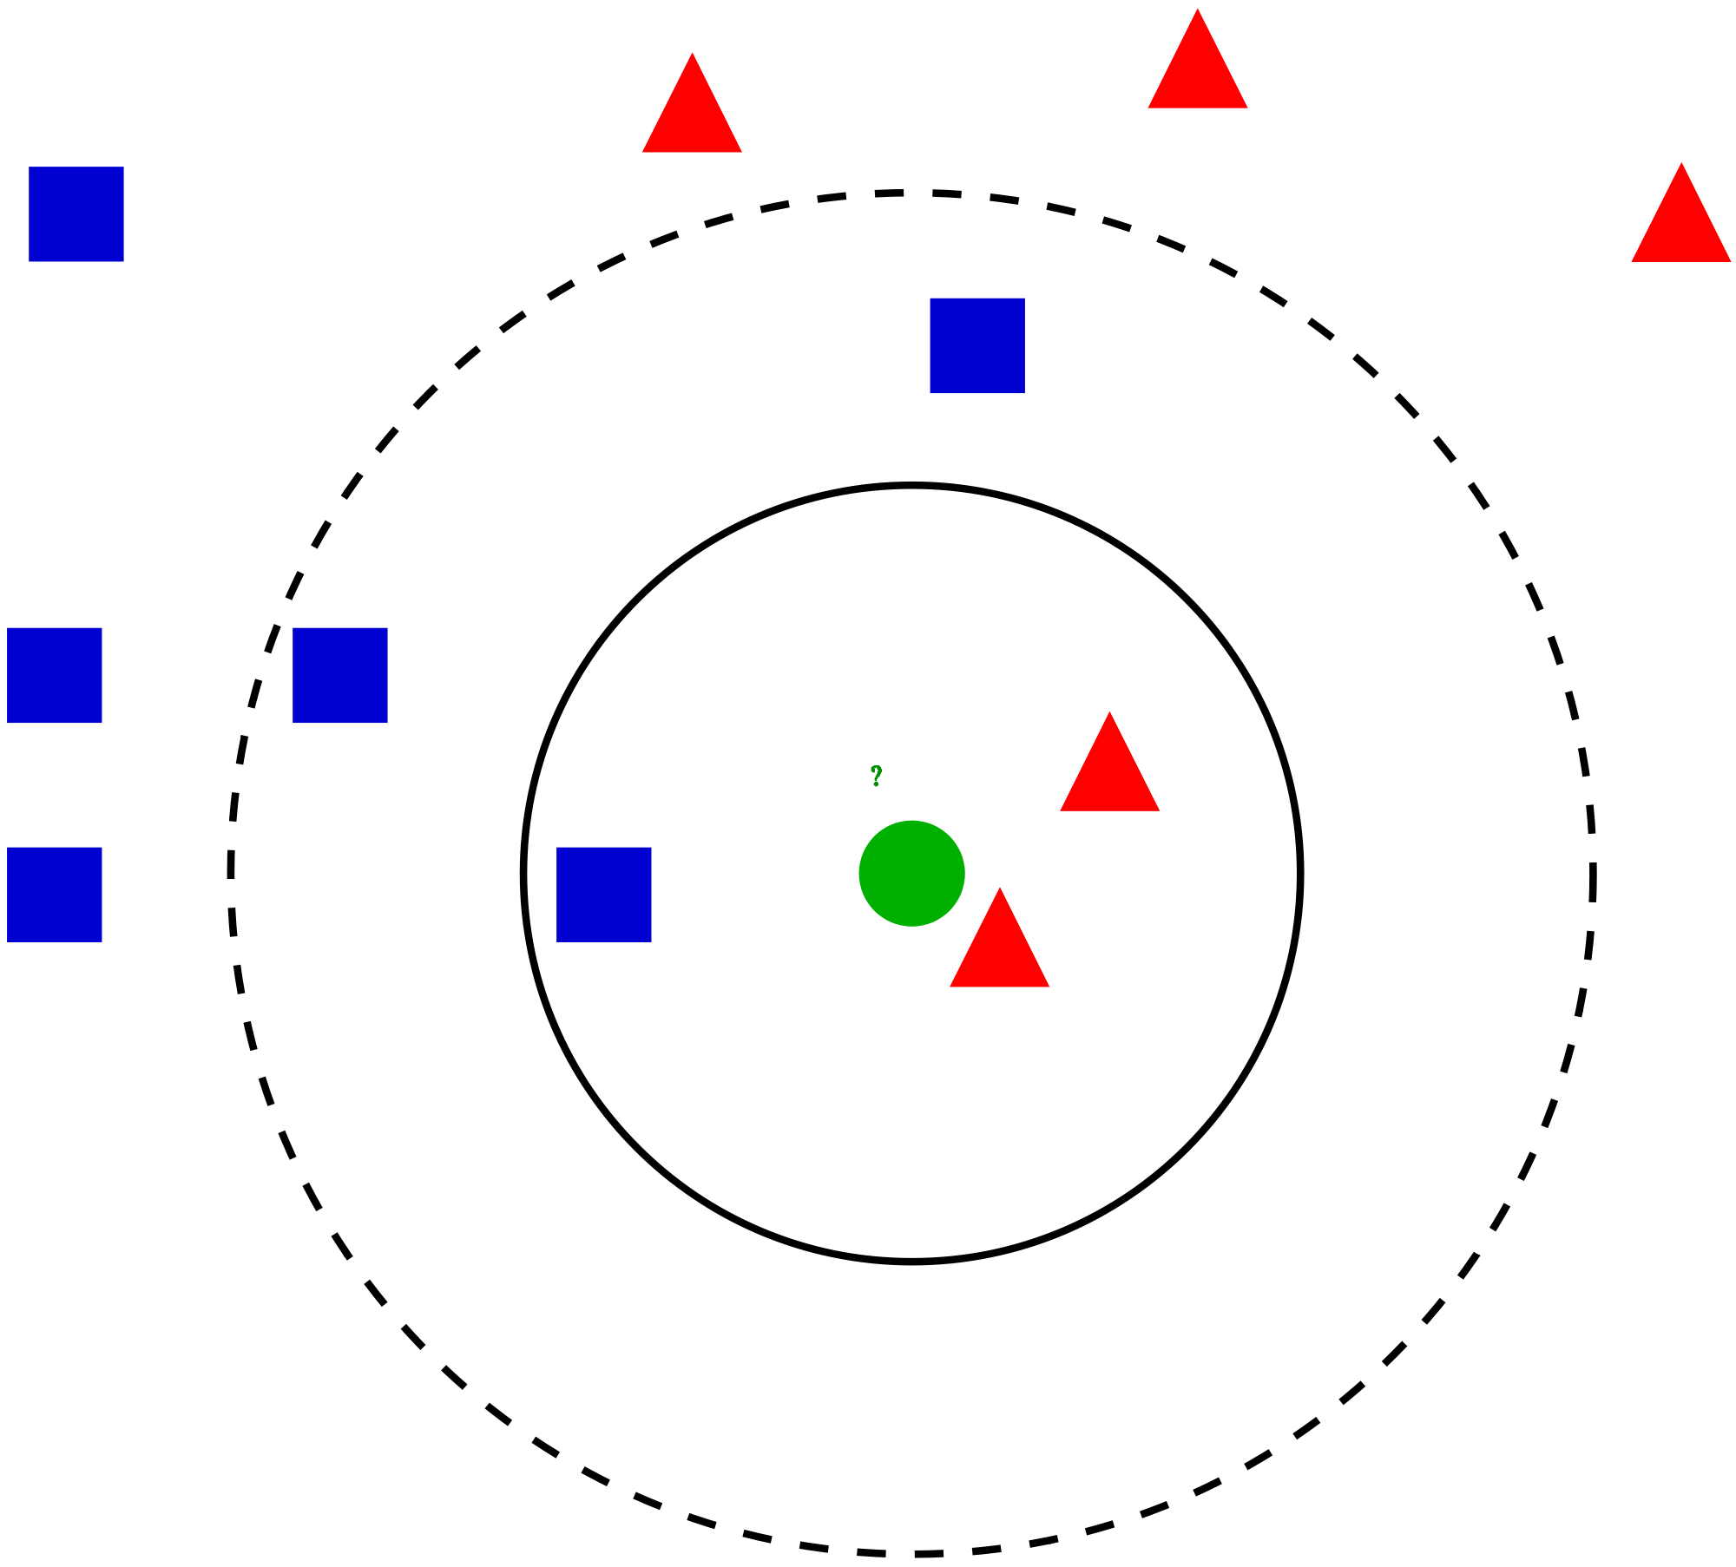
K = ?
Selection & Effect of “K” value

Slide 5

Effect of Value of K
Larger Value of K results in under fitting
Smaller Value of K results in over fitting
Value of K
Odd Numbers other than 1
Square root of total number of instances

Slide 6
START
Compute Euclidean Distance to all records in training set.
ALGORITHM STEPS
Load training data set.
Define value
of K.
Put the distances in the sorted list.
YES
Finished classification for each record.
NO
Select top K from the sorted list.
Define class of the test point based on number of similarities in selected K.
END

Slide 7

PROS AND CONS

Slide 8
[PROS]
SIMPLICITY AND INTUITIVENESS
NO TRAINING PHASE
ADAPTABILITY TO LOCAL PATTERNS
KNN is easy to understand and implement, making it accessible for both beginners and experts.
KNN is instance- based and doesn't require a separate training phase, making it efficient for real-time applications or scenarios with dynamic data.
It effectively captures local patterns and variations in the data, making it suitable for situations where global assumptions may not hold.

Slide 9
[CONS]
Computational Intensity
Sensitivity to Outliers
Memory Usage
KNN can be computationally expensive, especially as the dataset size increases, since it requires calculating distances between the query point and all data points.
Outliers can significantly impact KNN's performance, as they may dominate the decision- making process due to their influence on distance calculations.
As it stores the entire training dataset, KNN can be memory- intensive, limiting its application in scenarios with large datasets.

Slide 10


APPLICATION

Slide 11
[APPLICATION]
Recommendation
System
Medical
Diagnosis
Spam
Filtering

Slide 12
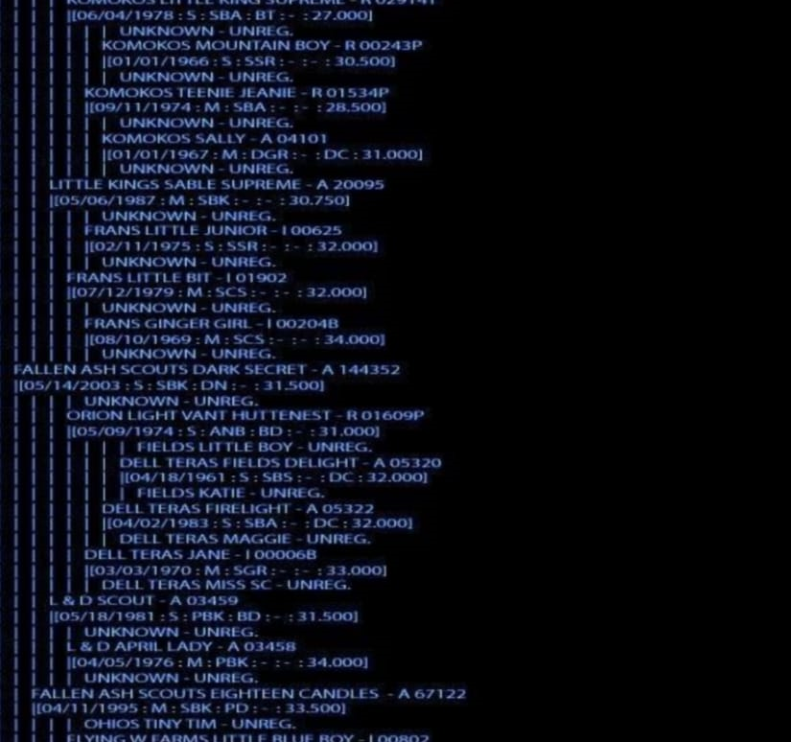
CODE

Slide 13
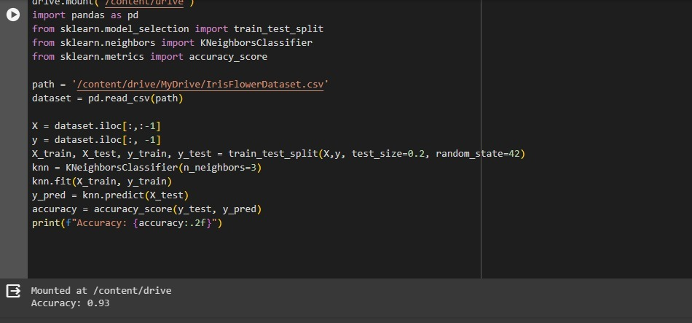
Code demonstrates the typical workflow for training and evaluating a machine learning model using K-Nearest Neighbors on the iris flower dataset.

Slide 14



TOOLS:----------------
GOOGLE COLAB
LANGUAGE:----------
PYTHON

Slide 15
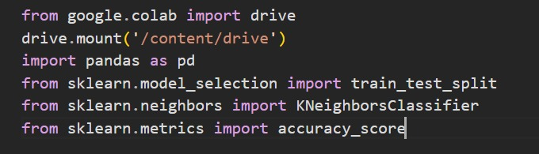
LIBRARIES
The code starts by importing necessary libraries, including Google Colab's drive module for accessing files, pandas for data manipulation, and scikit-learn's components for splitting the data, implementing the K-Nearest Neighbors classifier, and evaluating accuracy.

Slide 16

CODE BREAK-DOWN

Slide 17
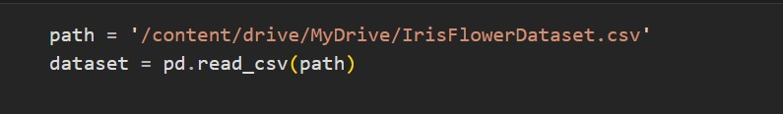
DATA LOADING
The code reads a CSV file named 'IrisFlowerDataset.csv' into a pandas DataFrame called dataset.

Slide 18
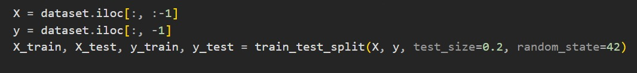
DATA SPLITTING
The dataset is split into features (X) and target labels (y). Then, the data is further divided into training and testing sets using the train_test_split function.

Slide 19
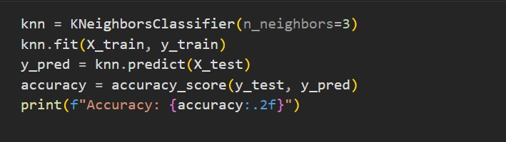
KNN MODEL TRAINING AND EVALUATION
A K-Nearest Neighbors classifier with 3 neighbors is instantiated, trained on the training data, and used to predict the labels of the test set. The accuracy of the model is then calculated and printed.

Slide 20

OUTPUT

